Slide 2
BOM Trip to Haiti 2019
Feed My Lamb Ministry (FMLM) – providing a home environment for children that have lost their parents or have been abandoned at their doorstep.
Dates: March 30 to April 7, 2019 (Adults and Students)
April 6 to April 14, 20-19 (Adults only)
Cost: Estimated to cost $1,900 to $2,300 (Airfare $900 + accommodation $500 to 1,100 + donation $500).
Project: Building a house for one of the Haitian Leaders of FMLM, who is vital to the continued successful operation of the Ministry

Slide 3
Feed My Lambs Ministry
Established 7 years ago in Haiti by Bermudian Philip Rego.
Most Haitians suffer from extreme poverty, food shortages, poor housing, lack of education and little medical care.
Phillip, his team and donors have funded, built and operated an orphanage (55 children), a school (700 students) and a medical clinic for the local people.

Slide 4
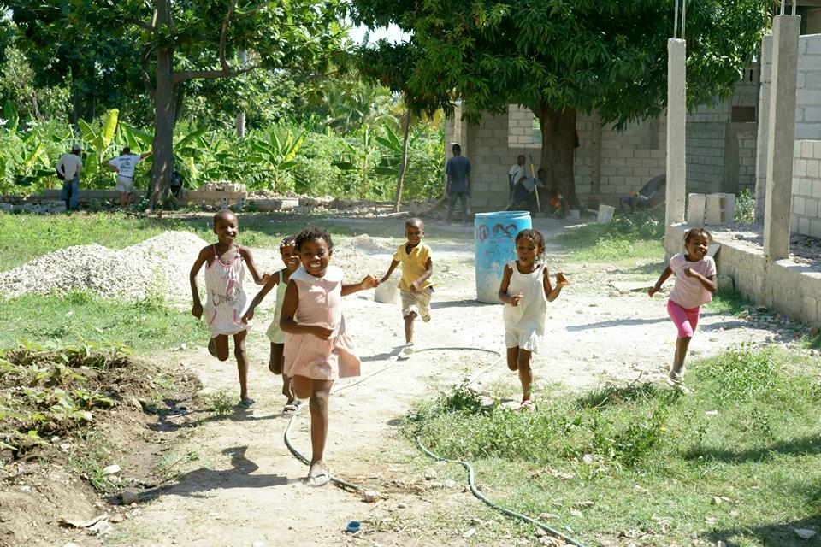
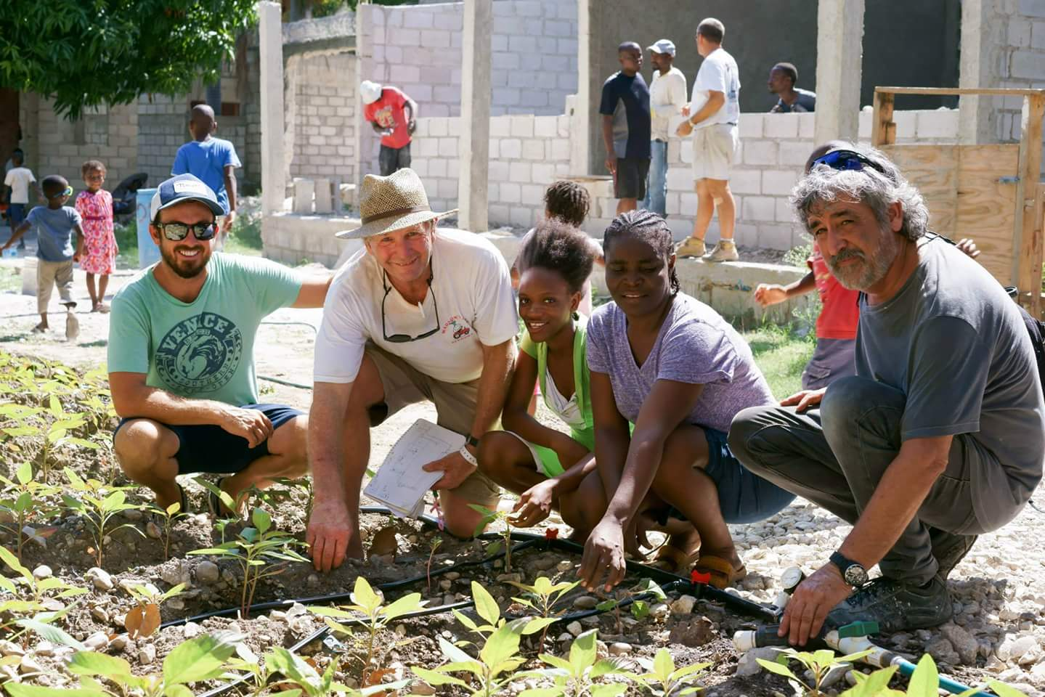
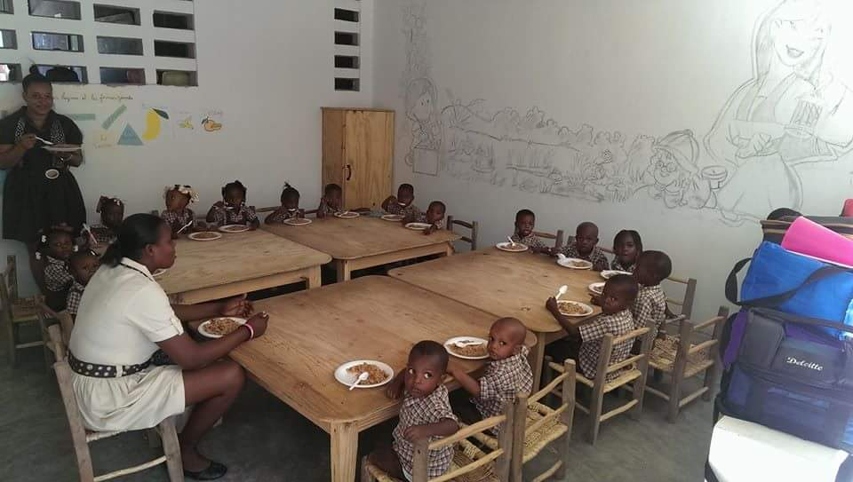

Slide 5
Health Considerations
Travel Health Clinic will provide vaccination requirements:
Typical Vaccinations:
Typhoid
Yellow fever
Tetanus
Hepatitis A and B
Malaria – Malarone pills

